Slide 1
A Classifying Model for Dysgraphia-Written Numbers
Germán E. Baltazar Reyes
05/31/2022

Slide 2
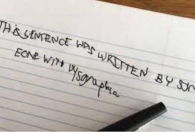
Dysgraphia
Definition
A learning disorder that affects people’s written communication skills^{1,2}.
Symptoms
Illegible writing
Inconsistencies on irregular sizes and spacing between words and letters

Slide 3
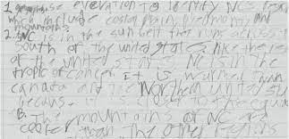
Dysgraphia
Definition
A learning disorder that affects people’s written communication skills^{1,2}.
Symptoms
Unfinished words or letters
Cramped writing

Slide 4
Why is it relevant?
There are no current federal laws that enforce proper treatment and ensure proper learning environments.
10-30%
7-15%
In the US³
Globally⁴
Children with some level of writing difficulties
Are actually diagnosed with dysgraphia

Slide 5
Use a classification algorithm to analyze hand-written symbols and determine its real representation

Slide 6
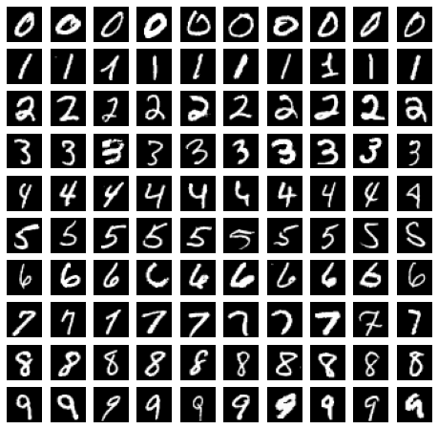
MNIST Dataset
Compound of 70,000 images of 28x28 pixels representing numbers from 0 to 9
Description
60,000 for training the model
10,000 for testing
Normalization of data

Slide 7
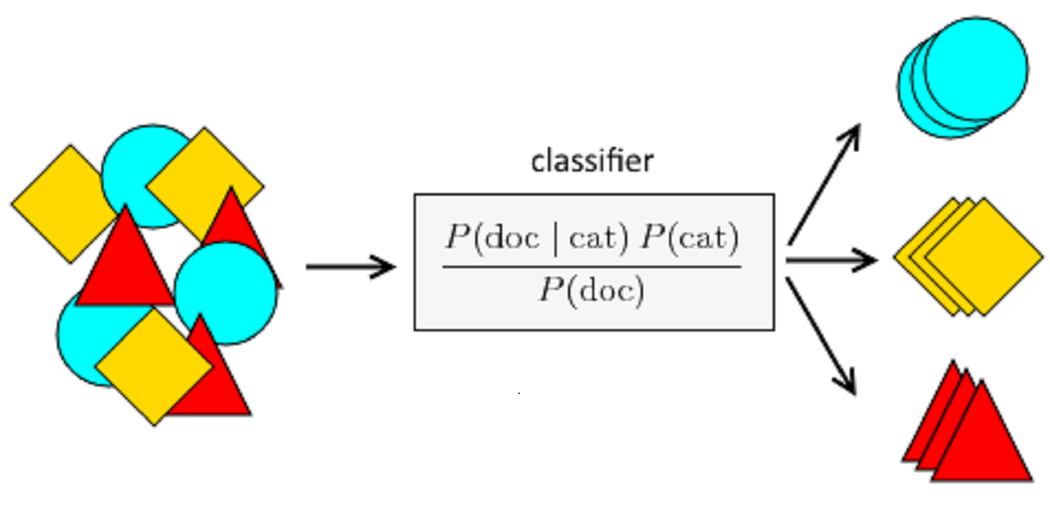
Bayes Classification
Use of naive and non-naive (Gaussian) version of a Bayes classification model
Tuning of epsilon for better accuracy

Slide 8
Results
 | Epsilon | Training accuracy | Testing accuracy
Naive Bayes model | 0.01514286 | 0.8024 | 0.8148
Gaussian Bayes model | 0.03332653 | 0.9597 | 0.9563

Slide 9
Conclusions
1
3
Gaussian Bayes classifier is capable of correctly interpreting handwritten numbers into their corresponding values.
Could be used as a first approach for improving the expressive capabilities of children with dysgraphia.
The model can be finetuned for detecting alphanumeric characters
2

Slide 10
Thank you!
Any Questions?

Slide 11
Appendix
References
Epsilon finetuning
Epsilon finetuning
Epsilon finetuning
Naive Bayes
Gaussian Bayes
Confusion matrix
Confusion matrix
Confusion matrix
Naive Bayes
Gaussian Bayes

Slide 12
References
International Dyslexia Association. https://dyslexiaida.org/understanding-dysgraphia/#:~:text=Thus%2C%20dysgraphia%20is%20the%20condition,and%20speed%20of%20writing%20text.
https://tourette.org/resources/overview/tools-for-educators/classroom-strategies-techniques/disgraphia/
Chung, Peter J et al. “Disorder of written expression and dysgraphia: definition, diagnosis, and management.” Translational pediatrics vol. 9,Suppl 1 (2020): S46-S54. doi:10.21037/tp.2019.11.01
Döhla, Diana, and Stefan Heim. “Developmental Dyslexia and Dysgraphia: What can We Learn from the One About the Other?.” Frontiers in psychology vol. 6 2045. 26 Jan. 2016, doi:10.3389/fpsyg.2015.02045

Slide 13
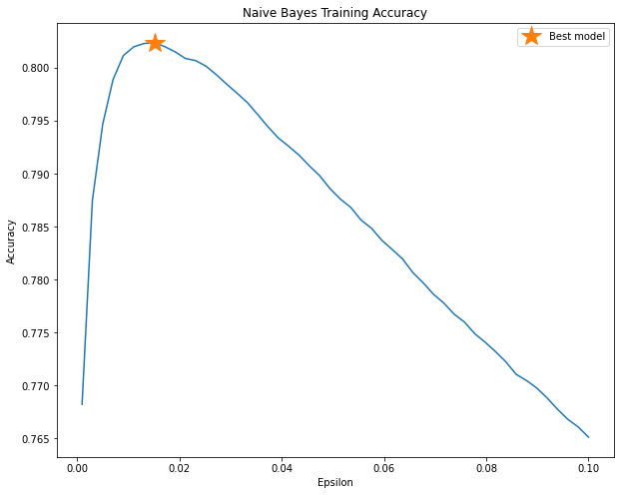
Naive Bayes finetuning
Epsilon = [0.001 to 0.1]
50 equally-separated values
Selected the one with the highest accuracy

Slide 14
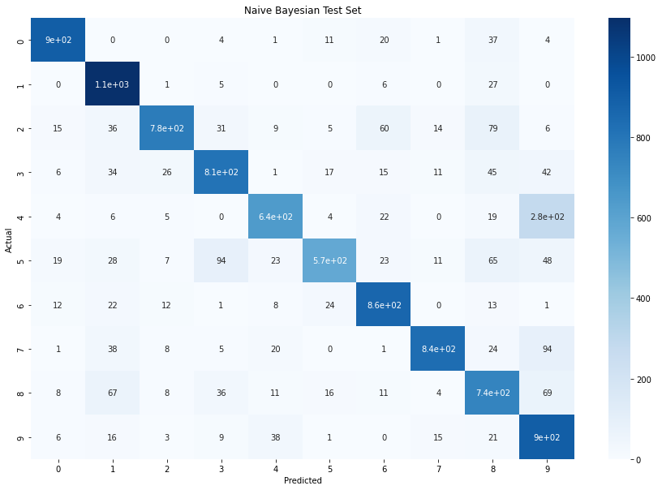
Naive Bayes confusion matrix
Training accuracy = 80.24%
Test accuracy = 81.48%
Problems evaluating 4s and 9s

Slide 15
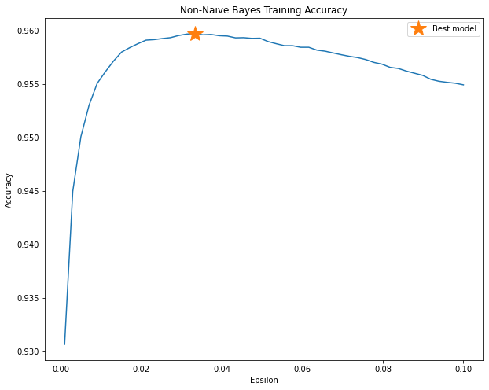
Gaussian Bayes finetuning
Epsilon = [0.001 to 0.1]
50 equally-separated values
Selected the one with the highest accuracy

Slide 16
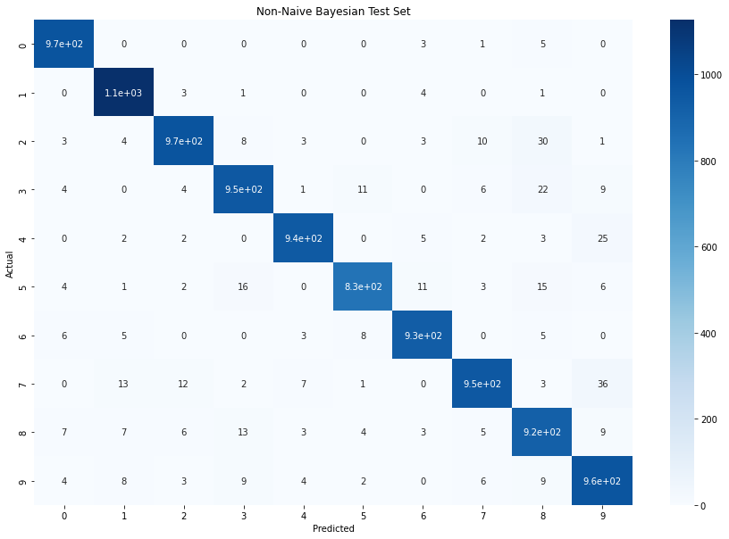
Gaussian Bayes confusion matrix
Training accuracy = 95.97%
Test accuracy = 95.63%
Problems evaluating 7s and 9s

